Slide 1

Autonomous tagging of stack overflow questions
BY TEAM NEURAL KNIGHTS

Slide 2
INTRODUCTION
This prototype is designed to automate the process of tagging of Stack Overflow questions.
Presently, a human interference is required to assign tags to the questions posted on the Website.
This turns out to be a cumbersome process and takes a lot of time to tag each and every questions and categorize the same

Slide 3
Existing problem
In the existing scenario, a human intelligence is required to deal with tagging and categorization of Stack Overflow questions which may lead to certain human errors and it is an ineffective process of carrying out this issue.
Here, one needs to read each and every question and assign tags to the same. This may be inaccurate at times.

Slide 4
PROPOSED SOLUTION
Based on the above issue, we have proposed a solution where a Web application incorporated with well-trained model helps in analyzing the ingested question and predict the suitable tag for the same.
This provides relevant tags for the question job of tagging and categorization.
This increases the efficiency of work and accurately assign tags at the time of posting the question into the website.
It reduces the time taken to tag and categorize the questions in Stack Overflow

Slide 5
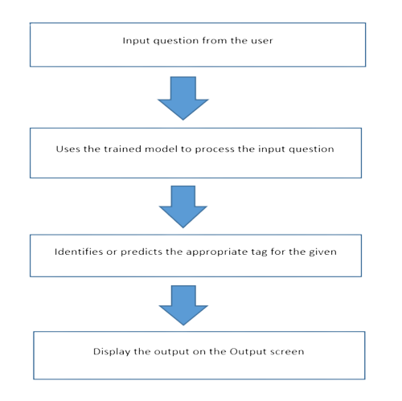
THEORITICAL ANALYSIS

Slide 6
Experimental analysis
This method can be used by different web portals where people post different questions (e.g., Reddit, Quora, etc..). This enhances the time consumed in tagging and categorizing the questions posted.
Model can be trained on timely basis using IBM watsonx for better usage and prediction capability.
It also provides accurate tags for the questions posted.

Slide 7
result
The objective of this solution is to create a website or GUI which is integrated with well trained model provides the following capabilities.
This model accurately predicts the questions posted in it.
A simple interface which can be directly incorporated in the website.
So, this is how we built our Autonomous Tagging of Stack Overflow questions using machine learning.

